Slide 1
CSE322
Linear Bounded Automaton & NDTM
Lecture #38

Slide 2
Linear Bounded Finite Automaton
A set of Context Sensitive Language is accepted by LBA.
The infinite storage is restricted in size but not in accessibility to storage in comparison with Turing Machine Model.
Is used to restrict( to bound) the length of the tape.

Slide 3
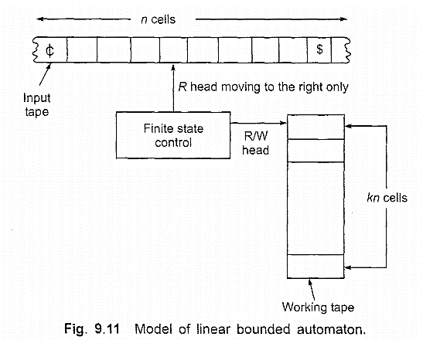


Slide 4
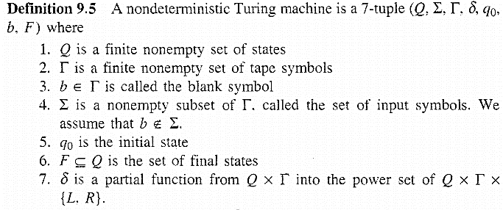
Non Deterministic Turing Machine

